Slide 1


Security Camera
AI Assignment |
Submitted By : Mayank Agrawal (2019IMG036)
Security Camera with Motion Detection and automatic alert system

Slide 2

Introduction of the Project
In today's competitive environment, the security concerns have grown tremendously. In the modern world, possession is known to be 9/10'ths of the law. Hence, it is imperative for one to be able to safeguard one's property from worldly harms such as thefts, destruction of property, people with malicious intent etc. Due to the advent of technology in the modern world, the methodologies used by thieves and robbers for stealing has been improving exponentially. Therefore, it is necessary for the surveillance techniques to also improve with the changing world. With the improvement in mass media and various forms of communication, it is now possible to monitor and control the environment to the advantage of the owners of the property.
The goal of this Project is to determine if there are any faces and also bodies in video feed. If any faces or bodies(Person) are present, then it will send a alert message to recipient’s number.

Slide 3

Motion Detection
Face & Body Detection
01
03
Message System
02
Space for Improvement
04
Abstract of the Project
It will play sound or alert through whenever motion is detected
This will only trigger the message and alert system whenever face and body is detected this will prevent it from unnecessary motion of insects
For remote notification as a SMS with time of detection.
Vast improvement is possible in this Project which can have many future Benefits.

Slide 4
Methodology
Python Libraries
Aimed at real-time computer vision. And used to recognize face and body
OpenCV
SinchSMS
Used to send an alert through SMS.
Used to play sound on Speaker
pyttsx3
time
Current time will be added in the message.

Slide 5

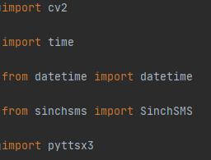
Code Expain !
Libraries
Here are all the Libraries which are used in the project.
OpenCV (cv2) : OpenCV is a cross-platform library using which we can develop real-time computer vision applications. It mainly focuses on image processing, video capture and analysis including features like face detection and object detection.
Time & datetime : Used to work with dates as date objects & also used to wait for specific time to settle.
SinchSMS : A module to send sms using the Sinch REST apis
Pyttsx3 : pyttsx3 is a text-to-speech conversion library in Python

Slide 6
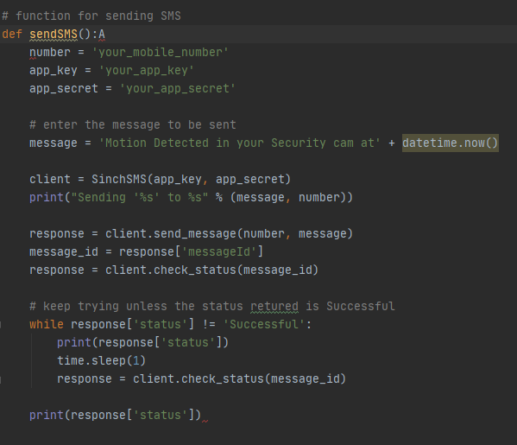
Code Expain !
SendSMS
This is a module to send SMS on Phone.
Mobile Number of recipient is required.
Create a app on Sinch and get the key and secret of the app and use these credentials in the following script to send SMS to your mobile. – this will required premium membership
Message is body of the message which you want to send.
After that there will be response from server side and that response must be successful so we will keep trying until that.

Slide 7
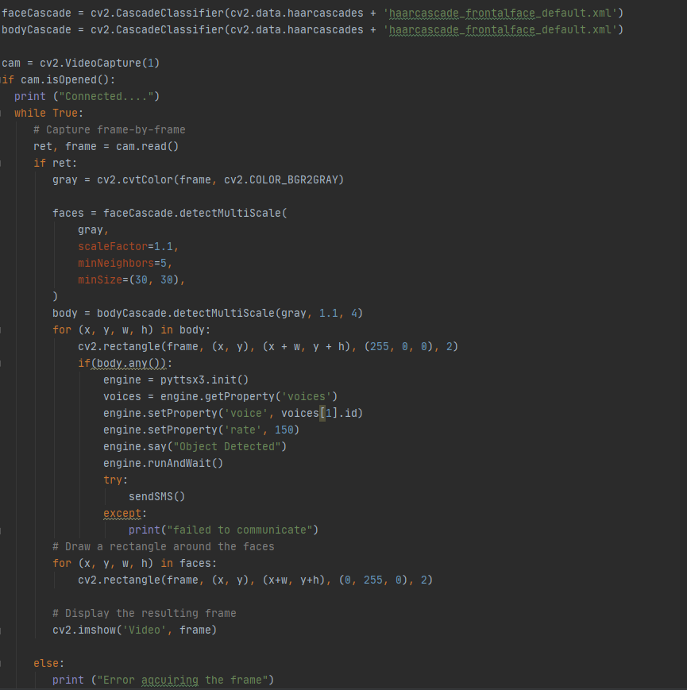
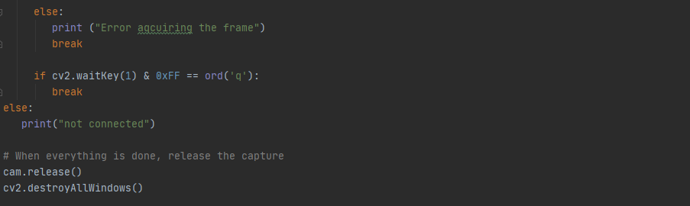
Code Expain !
Visualisation & Sound Alert
Here are Cascade Classifiers which have preloaded data for Body and Face Recognition. It’s download from the internet.
And then there is just simple code but I between we are checking for motion detection by any changes happened in body or face detection loop and there it will play sound and send SMS.

Slide 8
Raw Code
import cv2
import time
from datetime import datetime
from sinchsms import SinchSMS
import pyttsx3
# function for sending SMS
def sendSMS():A
number = 'your_mobile_number'
app_key = 'your_app_key'
app_secret = 'your_app_secret'
# enter the message to be sent
message = 'Motion Detected in your Security cam at' + datetime.now()
client = SinchSMS(app_key, app_secret)
print("Sending '%s' to %s" % (message, number))
response = client.send_message(number, message)
message_id = response['messageId']
response = client.check_status(message_id)
# keep trying unless the status retured is Successful
while response['status'] != 'Successful':
print(response['status'])

Slide 9
Raw Code
time.sleep(1)
response = client.check_status(message_id)
# keep trying unless the status retured is Successful
while response['status'] != 'Successful':
print(response['status'])
time.sleep(1)
response = client.check_status(message_id)
print(response['status'])
faceCascade = cv2.CascadeClassifier(cv2.data.haarcascades + 'haarcascade_frontalface_default.xml')
bodyCascade = cv2.CascadeClassifier(cv2.data.haarcascades + 'haarcascade_frontalface_default.xml')
cam = cv2.VideoCapture(1)
if cam.isOpened():
print ("Connected....")
while True:
# Capture frame-by-frame
ret, frame = cam.read()
if ret:
gray = cv2.cvtColor(frame, cv2.COLOR_BGR2GRAY)
faces = faceCascade.detectMultiScale(
gray,
scaleFactor=1.1,

Slide 10
Raw Code
minNeighbors=5,
minSize=(30, 30),
)
body = bodyCascade.detectMultiScale(gray, 1.1, 4)
for (x, y, w, h) in body:
cv2.rectangle(frame, (x, y), (x + w, y + h), (255, 0, 0), 2)
if(body.any()):
engine = pyttsx3.init()
voices = engine.getProperty('voices')
engine.setProperty('voice', voices[1].id)
engine.setProperty('rate', 150)
engine.say("Object Detected")
engine.runAndWait()
try:
sendSMS()
except:
print("failed to communicate")
# Draw a rectangle around the faces
for (x, y, w, h) in faces:
cv2.rectangle(frame, (x, y), (x+w, y+h), (0, 255, 0), 2)
# Display the resulting frame
cv2.imshow('Video', frame)

Slide 11
Raw Code
else:
print ("Error aqcuiring the frame")
break
if cv2.waitKey(1) & 0xFF == ord('q'):
break
else:
print("not connected")
# When everything is done, release the capture
cam.release()
cv2.destroyAllWindows()

Slide 12
Result and Discussion
By writing the above code we have made the Security System using OpenCV
Library to detect difference between frames and thus detect moving object in
a video feed. We also explored many Python libraries like pyttsx3, SinchSMS
etc. which can do Many tasks as discussed in above Slides but this is not the
limitation this is just the beginning. we can add endless functionalities to our
security camera to make it more smart.
It can be very useful for Security in Home, Bank , Office etc.

Slide 13
Conclusion And Future upgradation
OpenCV is for image/video processing and computer vision. Free and open
source (BSD licensed) Cross-platform and actively developed (also
downloaded over 3 million times)! This presentation covered just a few of the
over 2,000 algorithms available in OpenCV.
In Future, The only problem in using OpenCV algorithms is that they can be
spoofed easily or they can detect false faces. The anti-spoofing techniques
can be used when our system is used for security purpose. It can be solved by
eye-tracking & we can use face tracking with time.
we can use Face Detection & Body Detection data for counting no of
people in the room.

Slide 14

End of Slide
THANKS!

